Slide 1




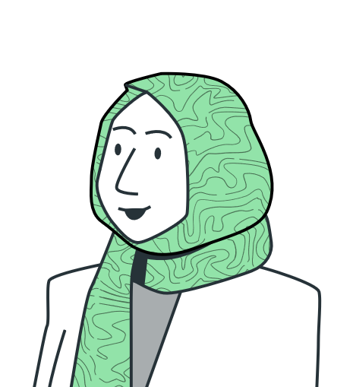
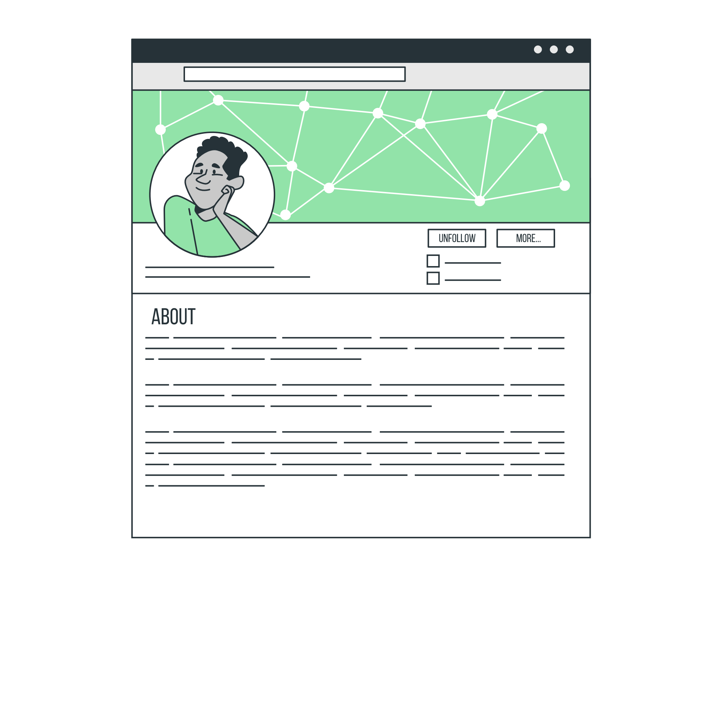
B-SAFE
It doesn’t matter where you go, Be safe!
Shao-Wen Chang
Asadujaman Nur
Vincent Chinedu Obigwe
Nureni Abeeb Opeyemi
Miguel Rodriguez
Marwa Hassan

Slide 2
MISSION & VISION
Mission We strive to offer our customers the best quality and safest gadgets with convenience and sustainability at heart.
Vision To create the most compelling safety company by driving sustainable and environmentally friendly safety solutions for various age groups.

Slide 3



CHANGES TO THE COMPANY
Constraint
Reduction
Organization
Notes:
Wen
: with the mission and vision in mind, we soon established 3 products to achieve our goals. However, due to our financial constraints as a startup(as professor advised), we made a reduction by deciding to publish the product that can help us build a repository first, smartacc.
: at the same time in the company, we established a clear and organised structure for the company by assigning everyone with different position and varied field of responsibility so each one of us have different input to keep in mind for the company's development.

Slide 4
RECRUITMENT PROCESSES
Recruitment is one of the toughest task. We were able to achieve that through:
Assessment
Placement
Intern consideration.
Interview
Selection
Onboarding
Notes:
Recruitment is one of the toughest task. We were able to achieve that through:
Assessment of the various roles needed.
Placement of attractive Job ads to be able to attract top talent.
Consideration of learners in our company by creating role for an intern.
Interview of the applicants.
Choosing the best/ most suited.
Onboarding

Slide 5
MARKETING STRATEGY
Who?
How?
Where?
Mode.
Notes:
Who - As a start-up company that is into a Technologically and safety driven product
How - Effective and Efficient products that works even without internet.
Where - Becoming a leading company in bike safety gadget i.e. Money = excellent product service
Mode - Partnership with networking company, Internet ads and media adverts

Slide 6
FUTURE PLAN
Financial Independency.
Product Sells.
Next Generation Products.
Patent Certificate.
Green Commitments.
Recognition.
Notes:
To be financial independent after the second year.
To sell 100.000 units world-wide in the first year.
To release the next version of products by the end of the 2nd year.
Achieve product patent certificate by the end of the first year.
Use 1% profit for tree plantation in deforested places.
To be a well-known company in safety and location products around high-risk sporters by the end of 4th year.

Slide 7
CHALLENGES
Financial Management.
Customer’s Loyalty.
Data Vs Cyber security.
Qualified Candidates.
Business Growth.

Slide 8
SKILLS WE´VE LEARNED
Marwa : Elevator Pitch , Engineers Vs Mangers Mindset &mentality.
Wen: Deal with time zones and scheduling; with business languages to speak for marketing purposes and communication in businesses
Nur: Methods we can apply to communicate with the people from different country and culture even if there Is a language barrier.
Abeeb: Transformation of Engineering skills into Business with excellent and innovative ideas
Miguel: Select the best team to work with.
Vincent: Public speaking/Presentation.

